Slide 1

AWS Global Accelerator

Slide 2
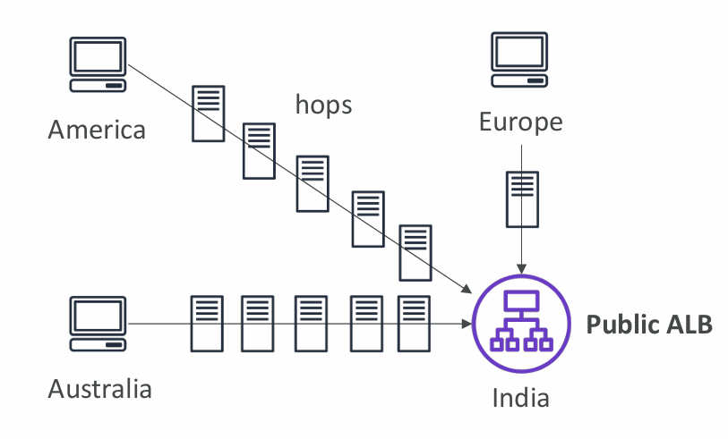
Global users for our application
• You have deployed an application and have global users who want to access it directly.
• They go over the public internet, which can add a lot of latency due to many hops.
• We wish to go as fast as possible through AWS network to minimize latency.

Slide 3
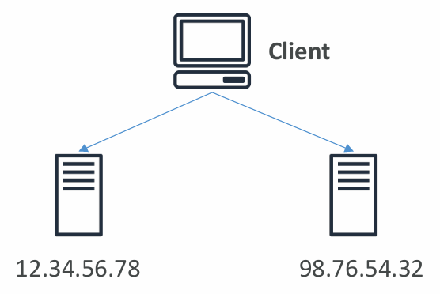
Unicast IP
Definition:
Unicast means one-to-one communication between a single sender and a single receiver.
A unique IP address is assigned to only one specific server, and all clients using that IP are routed directly to that server.
Example:
If your web server has the IP address 203.0.113.10:
Every client request to this IP will always reach that same server.
If that server goes down, users cannot reach your application.
Key Points:
One IP → One server
Simple setup
Single point of failure
Commonly used for local or single-region deployments

Slide 4
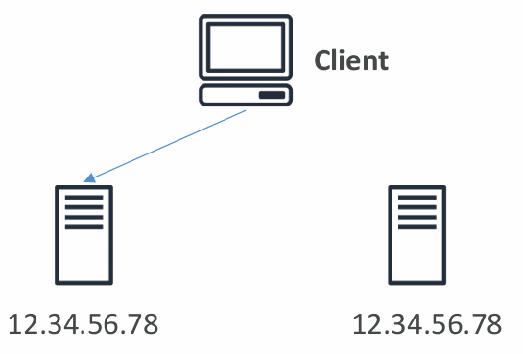
Anycast IP (Multiple Servers Share One IP Address)
Definition:
Anycast allows multiple servers in different geographical locations to share the same IP address.
When a client sends a request, it is automatically routed to the nearest or best-performing server based on network routing policies (usually BGP).
Example:
Suppose you have three servers:
One in the USA,
One in Europe,
One in Asia,
and all share the same IP address: 192.0.2.1.
Now:
A user in Pakistan will be routed to the Asia server.
A user in Germany will be routed to the Europe server.
A user in the US will be routed to the USA server.
Result:
Reduced latency (faster response)
High availability (if one server fails, another serves traffic)
Global scalability

Slide 5

AWS Global Accelerator
Overview
AWS Global Accelerator is a networking service that improves the availability, performance, and global reach of your applications.
It routes user traffic through the AWS global private backbone network, rather than the unpredictable public internet.
This ensures lower latency, higher reliability, and consistent performance for users around the world.

Slide 6

Main Features of AWS Global Accelerator
1. Uses AWS Internal Global Network
Normally, user traffic travels over the public internet, causing multiple hops and delays.
AWS Global Accelerator routes all requests through the AWS global private backbone network.
This network connects all AWS Regions and Edge Locations worldwide.
Result:
Reduced latency
Lower packet loss
Consistent global performance

Slide 7

2. Two Anycast IP Addresses Are Created
AWS provides two static Anycast IPs when you create an accelerator.
These IPs act as global entry points for your application.
Users worldwide connect to the same IPs — traffic automatically routes to the nearest AWS Edge Location.
Example:
User in Pakistan → Mumbai Edge Location
User in Germany → Frankfurt Edge Location
User in USA → Virginia Edge Location

Slide 8

3. Edge Locations Forward Traffic to Your Application
Once traffic reaches the nearest Edge Location, it enters the AWS private network.
The traffic is forwarded to your application endpoint, such as:
  Application Load Balancer (ALB)
  Network Load Balancer (NLB)
  EC2 Instance
  Elastic IP
Ensures:
Traffic follows optimized AWS routes, not the public internet.

Slide 9
4. Multi-Region Support & Automatic Failover
Automatically routes users to the nearest healthy AWS Region.
If an endpoint or region becomes unavailable traffic instantly redirects to a healthy one.
No DNS propagation delay : zero downtime for users.
5. Continuous Health Checks
Global Accelerator continuously monitors all application endpoints.
Unhealthy endpoints are automatically removed from routing.
Traffic is sent only to healthy, available endpoints.
Ensures:
High availability and automatic disaster recovery.

Slide 10
6. Static IPs (No DNS Dependency)
Provides two fixed IPs that stay constant — even if endpoints or regions change.
Simplifies IP whitelisting and removes DNS-based failover delays.
Ideal for enterprises needing stable IPs for firewall rules.
7. Security and Integration
Built-in integration with AWS Shield → protects against DDoS attacks.
Compatible with ALB, NLB, EC2, Elastic IPs.
Supports both TCP and UDP protocols → perfect for gaming, VoIP, real-time, and streaming apps.
Traffic stays within the AWS global network, enhancing security and reliability.

Slide 11
AWS Global Accelerator vs CloudFront
Feature | Amazon CloudFront | AWS Global Accelerator
Main Use | CDN (content delivery) | Global application routing
Traffic Type | HTTP/HTTPS | TCP & UDP
Content Handling | Caches content at edges | Forwards traffic via AWS network
Best For | Websites, APIs, videos | Games, IoT, VoIP, multi-region apps
Static IPs | Not supported | Supported
Failover Speed | Slower (DNS-based) | Instant (AWS routing)

